Slide 1
INPUT DEVICES
PRESENTATION PREPARED BY
ALBIR ASHFAQ

Slide 2
Definitions
An input device is a piece of equipment used to provide data and control signals to an information processing system
OR
An input device is any hardware device that sends data to a computer, allowing you to interact with and control it.

Slide 3
Examples
Keyboard
Microphones
USB
Mouse

Slide 4
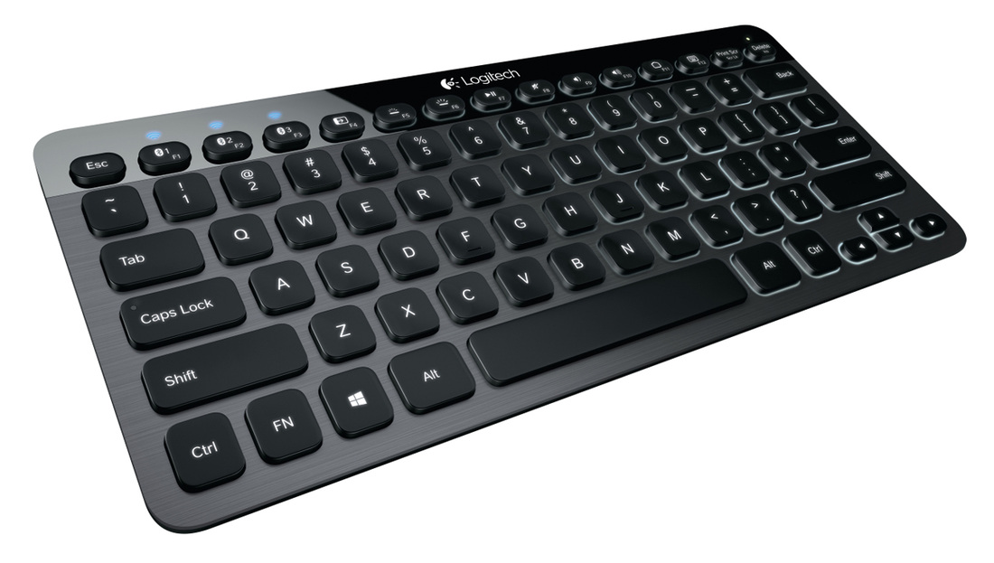
keyboard
A computer keyboard is an input device used to enter characters and functions into the computer system by pressing buttons, or keys.

Slide 5

Microphone
A microphone is an input device used to convert sound waves into electrical waves or to input sound into computers.

Slide 6
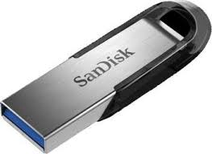
USB
USB---- UNIVERSAL SERIAL BUS
USB acts as both input and output device
The USB feeds information to the computer and information can be transferred

Slide 7
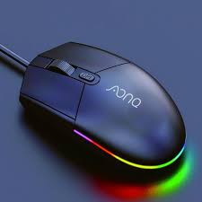
Mouse:
A mouse delivers location and selection data to the computer.

Slide 8
CONCLUSION
The purpose of an input device is to enable computer operators to have control of the computer and send data such as text, images, or sounds to the computer.

